Slide 1
Shell Bootcamp 2024 TECHNICAL FOUNDATION 3 Reflections for Week 2 (02-Sep-2024 – 06-Sep-2024)
Hitesh
Date : 06-Sep-2024

Slide 2

About Me
You can do anything, but not everything, so don’t hesitate to reach out help and collaborate.

Slide 3

My learnings from this week!

Slide 4
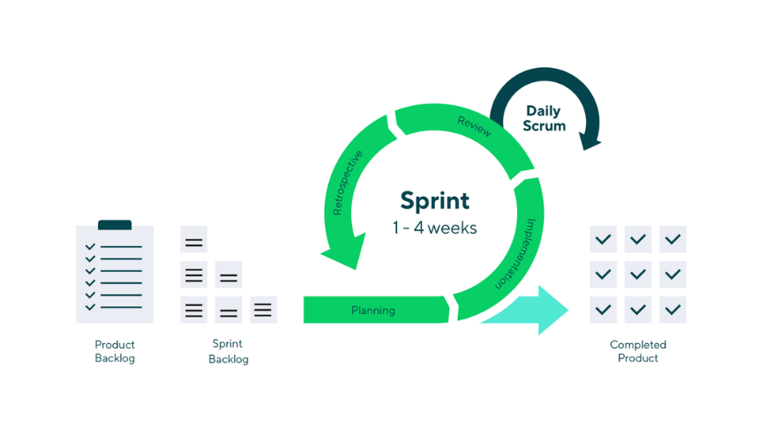
Learning 1 | My takeaways
AGILE/SCRUM
Key Learning:
Agile methodologies, particularly Scrum, emphasize iterative development, team collaboration, and adaptive planning to improve software delivery.
Key Takeaway:
Scrum enables teams to work in short, time-boxed iterations (sprints), allowing for frequent reassessment of progress and priorities. This iterative approach helps teams adapt to changing requirements and deliver value more efficiently.
Personal Implementation in the Energy Sector:
In the energy sector, Agile/Scrum can be implemented to manage complex projects such as the development of new energy solutions or the integration of renewable energy sources. By using Scrum, teams can adapt to evolving regulations, technological advancements, and stakeholder feedback more effectively, ensuring that projects remain aligned with current needs and objectives.

Slide 5
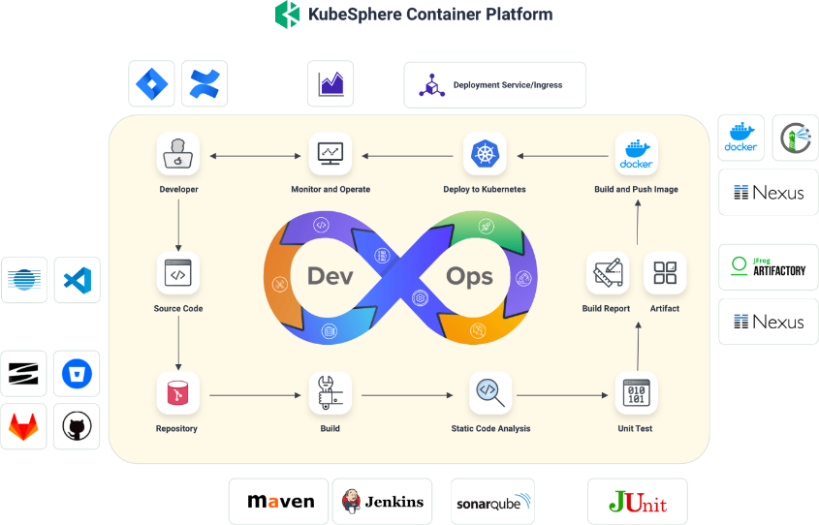
Learning 2 | My takeaways
DevOps
Key Learning:
DevOps is a cultural and technical movement that aims to improve collaboration between development and operations teams, enabling faster and more reliable software delivery through automation and continuous integration/continuous delivery (CI/CD).
Key Takeaway:
The DevOps approach focuses on automating the software development lifecycle (SDLC), integrating automated testing and deployment pipelines, and fostering a culture of continuous improvement. This leads to faster releases, higher quality software, and more efficient operations.
Personal Implementation in the Energy Sector:
DevOps can enhance the deployment and management of energy management systems and smart grid technologies. By automating deployments and integrating continuous testing, energy companies can improve the reliability and efficiency of their software systems, quickly adapting to new requirements or operational changes.

Slide 6
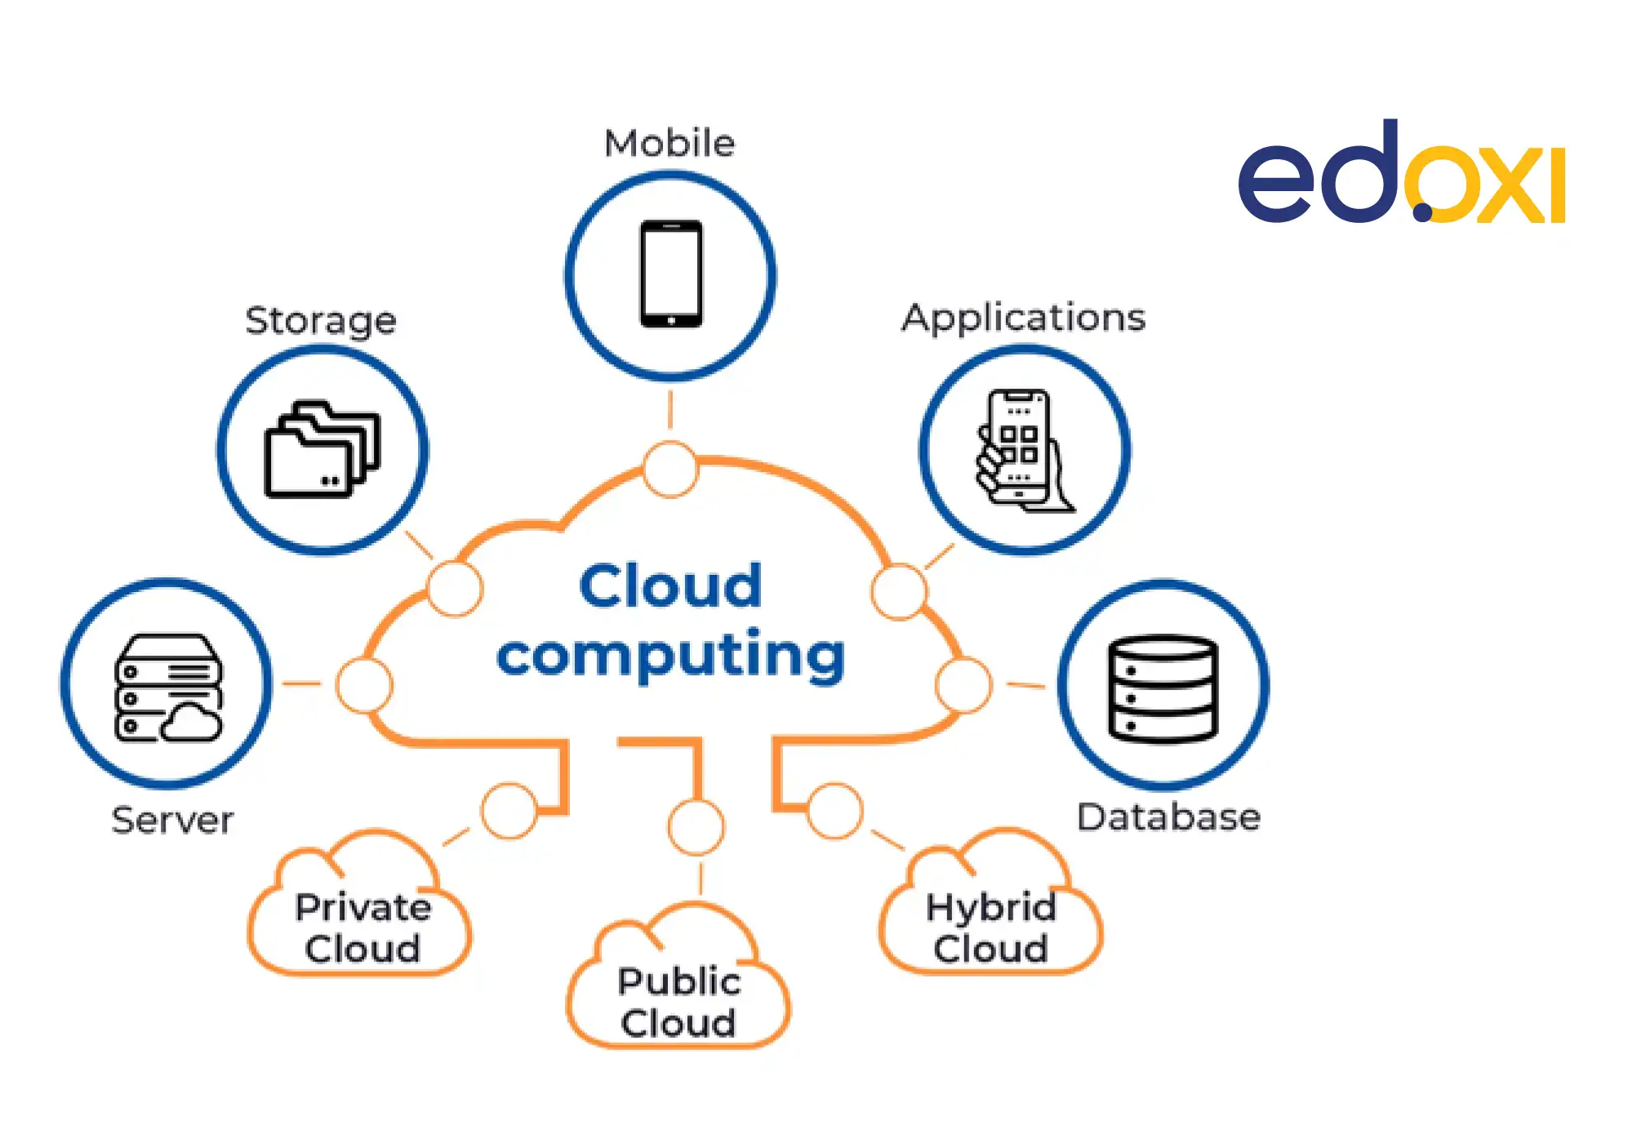
Learning 3 | My takeaways
Cloud & VM
Key Learning:
Cloud computing and virtualization (VM) provide scalable and flexible resources for deploying and managing applications, reducing infrastructure costs, and enabling efficient use of computing resources.
Key Takeaway:
Cloud services and VMs allow for on-demand access to computing resources and storage, with the ability to scale resources up or down based on demand. This flexibility supports cost-effective management and deployment of applications and services.
Personal Implementation in the Energy Sector:
In the energy sector, Cloud and VM technologies can be used to manage large-scale data analytics, support real-time monitoring systems, and deploy energy management applications. This enables companies to handle large volumes of data, scale their operations efficiently, and reduce the costs associated with physical infrastructure.

Slide 7

Relevance of learnings for my organization

Slide 8
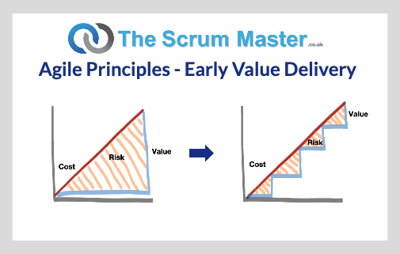
Learning 1 | Relevance for Shell
Agile/Scrum
How I feel Shell implements this learning:
Shell likely uses Agile methodologies and Scrum frameworks in its software development projects to enhance collaboration and adaptability. By breaking down complex projects into manageable sprints, Shell can iteratively develop and refine its software solutions, such as digital tools for energy management or exploration data analysis. Teams work closely together, regularly reassess project priorities, and make adjustments based on feedback and changing requirements.
How I feel Shell benefits from this learning:
Implementing Agile/Scrum helps Shell deliver software solutions more efficiently and responsively. It allows Shell to better adapt to the fast-paced changes in the energy sector, such as new regulations or technological advancements. This agility leads to more innovative and effective solutions, quicker response times to issues, and overall improved project outcomes.

Slide 9
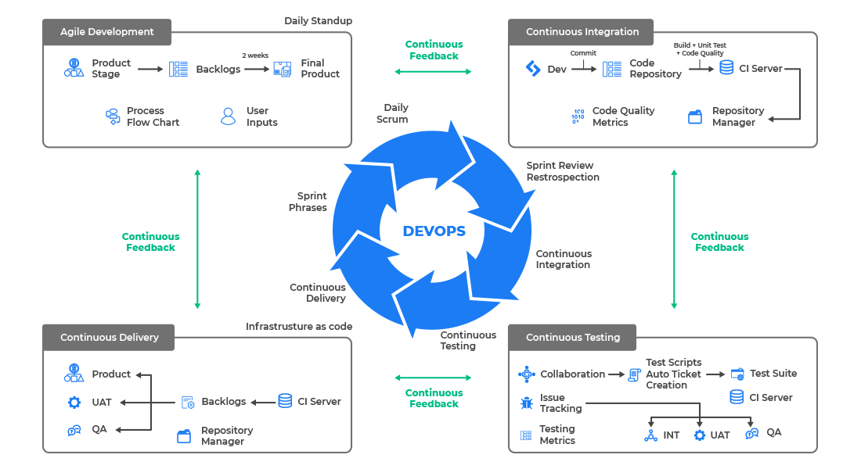
Learning 2 | Relevance for Shell
DevOps
How I feel Shell implements this learning:
Shell likely integrates DevOps practices to streamline its software development and operations processes. By automating build, test, and deployment pipelines, Shell ensures that its applications and systems are delivered faster and with higher quality. DevOps practices also foster collaboration between development and operations teams, improving communication and efficiency in managing software infrastructure.
How I feel Shell benefits from this learning:
The adoption of DevOps at Shell results in more reliable and rapid software releases, which is crucial for maintaining and enhancing Shell’s complex digital systems. Automated testing and deployment reduce the risk of errors and downtime, leading to more stable operations and the ability to quickly roll out updates or new features. This enhances Shell’s capability to innovate and maintain competitive advantage in the energy industry.

Slide 10

Learning 3 | Relevance for Shell
Cloud & VM
How I feel Shell implements this learning:
Shell utilizes cloud computing and virtualization to manage and scale its IT resources efficiently. By leveraging cloud services and virtual machines, Shell can deploy and manage applications and data analytics tools with flexibility and scalability. This approach supports Shell’s large-scale data processing needs and provides the infrastructure for various digital initiatives, such as real-time monitoring and predictive analytics.
How I feel Shell benefits from this learning:
Cloud and VM technologies offer Shell cost-effective and scalable solutions for managing its extensive IT infrastructure. The ability to quickly scale resources up or down helps Shell respond to fluctuating demands and optimizes operational costs. Additionally, these technologies enhance Shell’s ability to analyze and leverage data for better decision-making, improving overall operational efficiency and strategic planning.

Slide 11

Challenges in implementing learning

Slide 12
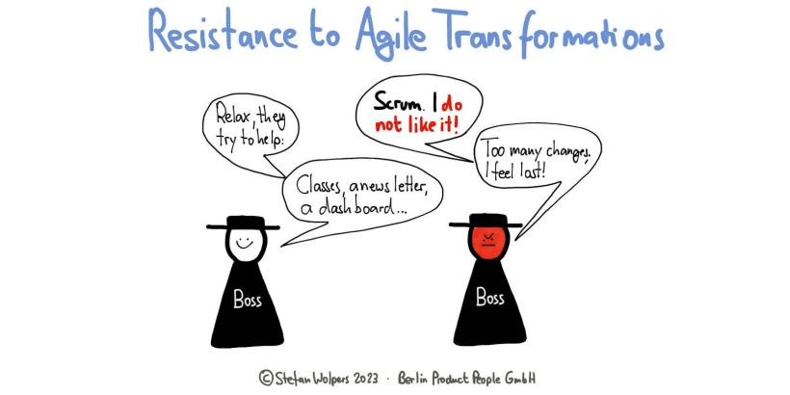
Challenge faced while implementing Learning 1
Agile/Scrum
Challenge Faced:
Implementing Agile/Scrum often involves resistance to change from team members accustomed to traditional project management methods. Additionally, ensuring that all team members are well-versed in Scrum practices and maintaining consistent communication can be challenging.
Plan to Overcome:
To address resistance, I would focus on providing comprehensive training and highlighting the benefits of Agile/Scrum, such as increased flexibility and faster delivery. Establishing regular Scrum ceremonies (e.g., daily stand-ups, sprint reviews) and fostering a culture of open communication and feedback will help in reinforcing Agile principles. Additionally, I would seek to involve key stakeholders early in the process to ensure their buy-in and support.

Slide 13
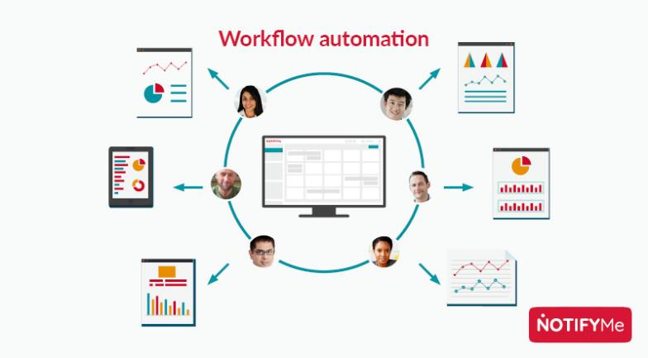
Challenge faced while implementing Learning 2
DevOps
Challenge Faced:
One challenge in implementing DevOps is the integration of automated tools and processes into existing workflows, which may require significant changes to current practices and tools. Additionally, aligning the development and operations teams with a shared DevOps culture can be difficult.
Plan to Overcome:
To manage tool integration, I would conduct a thorough assessment of existing workflows and select tools that complement current processes while providing clear benefits. Implementing gradual changes and providing training on new tools and practices will ease the transition. For cultural alignment, promoting collaboration through joint team activities and emphasizing the shared goals of improved efficiency and reliability will help foster a DevOps mindset.

Slide 14
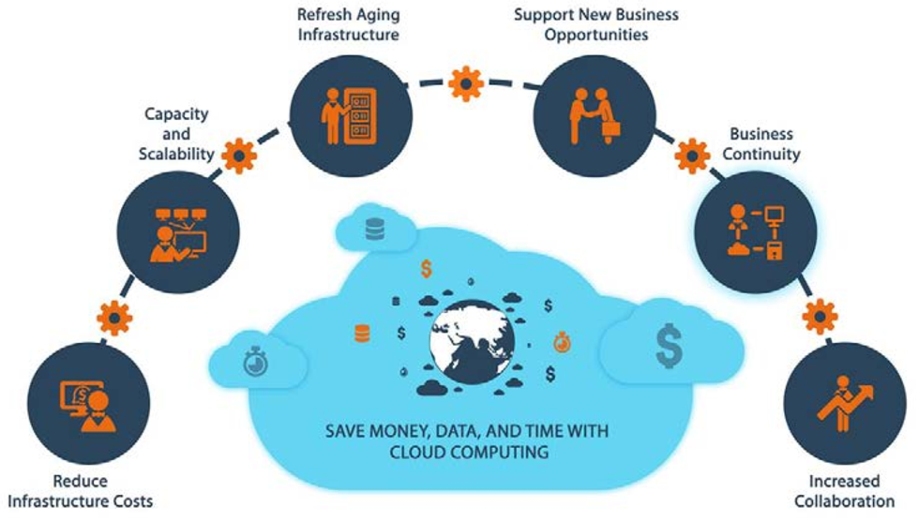
Challenge faced while implementing Learning 3
Cloud & VM
Challenge Faced:
A key challenge in adopting Cloud and VM technologies is managing the migration of existing systems and data to new environments, which can be complex and risky. Ensuring data security and compliance with regulatory requirements is also a concern.
Plan to Overcome:
To address migration challenges, I would develop a detailed migration plan with clear timelines and risk management strategies. Conducting pilot tests and using phased migrations can help minimize disruptions. For data security and compliance, I would work closely with IT and security teams to implement best practices and ensure that all cloud and VM deployments meet regulatory requirements. Regular audits and monitoring will help maintain compliance and address any issues promptly.

Slide 15

Action Plan

Slide 16
My Action Plan for this Week
Actions
Timeline
Status
Conduct a workshop to introduce Agile/Scrum principles to your team, including the benefits of adopting Scrum and how it will be implemented in upcoming projects.
Assess and identify current tools and workflows for potential integration with DevOps practices. Prepare a detailed plan for implementing automated build, test, and deployment processes, including necessary training for team members.
Develop a migration plan for transitioning existing systems to cloud and VM environments, focusing on identifying key systems and data for migration. Establish a security and compliance checklist to ensure regulatory requirements are met during the migration process.
Schedule and complete the workshop by the end of the week.
Complete the assessment and draft the implementation plan by mid-week.
Draft the migration plan and checklist by the end of the week.
To be started
In progress
To be started

Slide 17

Learning is also Fun!

Slide 18
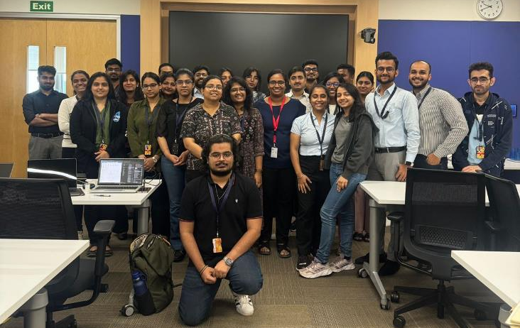
Learning is also Fun!
Activity: We engaged in a role play to demonstrate a Scrum meeting for the project "Billbuster." I took on the role of a developer addressing a user story from a homeowner who was concerned about receiving real-time updates on their energy consumption. This hands-on approach made the Scrum process more tangible and interactive.
Funny Incident: During the role play, there was a humorous moment when I accidentally mixed up the terms "sprint backlog" and "product backlog," leading to some playful confusion among the team. This slip-up turned into a valuable learning moment as we discussed the differences between the two backlogs and clarified their roles in the Scrum process.
Additional Fun Activities: To break up the intensity, we also did some origami and played Chinese whispers. These activities provided a refreshing diversion and helped lighten the mood, making the learning experience more enjoyable and memorable.

Slide 19

Summary
Quick Summary
This week, we focused on Agile/Scrum, DevOps, and Cloud & VM. We explored Scrum through a role play, implemented DevOps principles, and planned for cloud and VM migrations. Fun activities included origami and Chinese whispers, which added an engaging and light-hearted element to our learning process.
Importance of Topics for Upcoming Week
Next week, it's crucial to deepen our understanding of Agile/Scrum by implementing the concepts in real scenarios, refining our DevOps practices to enhance automation and integration, and progressing with our cloud and VM migration plans to ensure a smooth transition and compliance.
Connectivity of Topics from Current Week
The role play of Scrum meetings helped us practically apply Agile principles, which will be essential as we integrate these practices into our ongoing projects. Our DevOps efforts will benefit from the Agile framework by improving our development and operations workflows. Finally, the cloud and VM planning ties into our DevOps strategies by providing scalable and flexible infrastructure to support our automated processes.

Slide 20
Thank You

